Slide 1
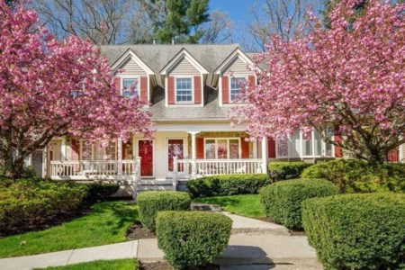
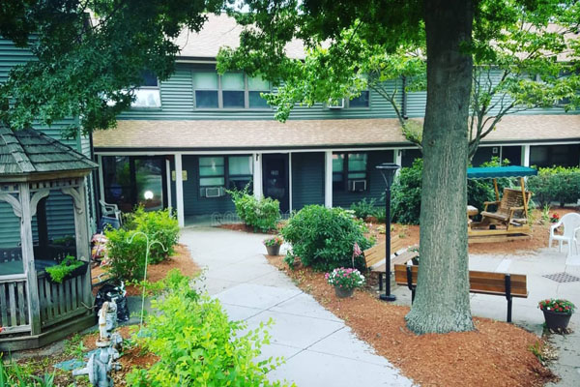
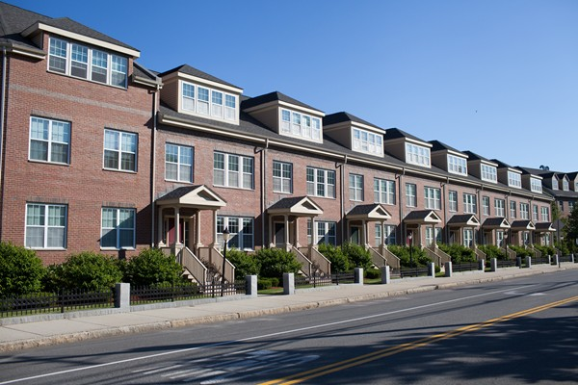
Affordable Housing in Andover MA
Prepared by
Lisa Schwarz
TOWN OF ANDOVER

Slide 2
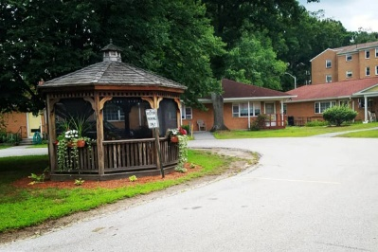
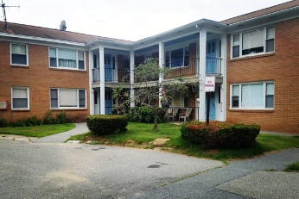
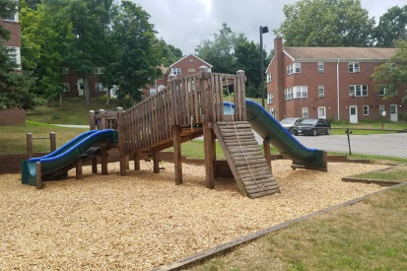
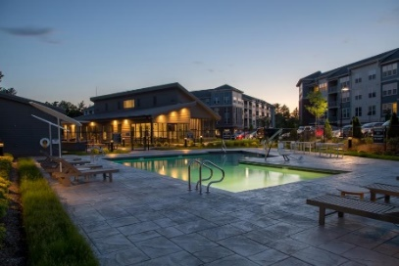
History of Affordable Housing in Andover
BACKGROUND
What is “Affordable Housing?” There are no precise definitions.
1) Housing units that are affordable by a section of society whose income is below the median household income.
2) As a general rule, you want to spend no more than 30 percent of your monthly gross income on housing. Renter, that 30 percent includes utilities,
Owner, it includes other home-ownership costs like mortgage interest, property taxes and potentially maintenance.
Affordable housing started in the Town of Andover with the first public housing built at Memorial Circle in the late 1940’s, Chestnut Court 1958, Grandview Terrace 1968, Frye Circle 1975 and Stowe Court 1982.
Public Housing was a result of the lack of new housing built after the Great Depression and World War II, which then created a short fall of housing. This was addressed with government financed construction projects to build government owned housing. In Andover, public housing is currently operated by the Andover Housing Authority, an entity that manages Federal aid and manages the public housing built in Andover over the years.
Affordable housing shifted in Andover in the 1980’s after the Commonwealth of Massachusetts passed Chapter 40B in 1969, which allows private developers to circumvent some local zoning bylaws if 20-25% of the units in the project are affordable and a community is below 10% of the housing affordability requirements.

Slide 3
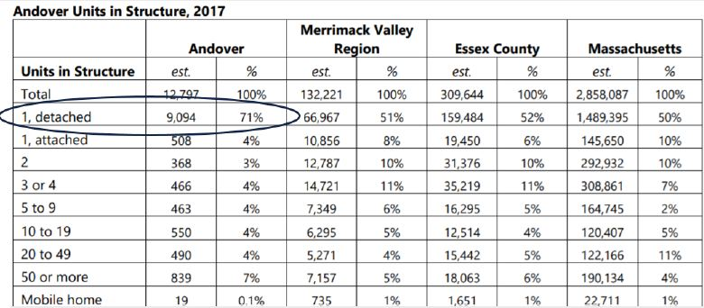
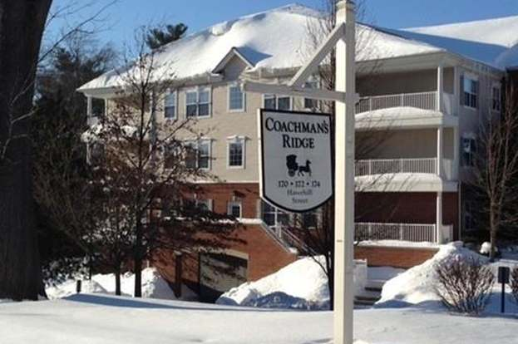
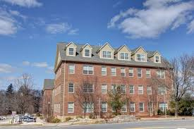
History of Affordable Housing in Andover
40B in Andover has produced almost 1383 housing units
Chapter 40B allows developers to override zoning laws to build all types of housing if a community is below the 10% threshold.
Inclusionary Zoning in Andover
Andover also has “Inclusionary Zoning” where zoning requires or encourages the creation of affordable housing units when Market Rate Housing is developed. Andover has produced 556 units of housing using zoning, of which 227 are restricted as affordable.
Approximately 71% of Andover’s housing stock is Single Family Detached homes, the other 29% is a mix of 2 or more units.
Inclusionary Zoning and 40B have allowed alternative types of housing to be built such as rental units, condominiums and townhouses all in a variety of locations and price ranges.

Slide 4
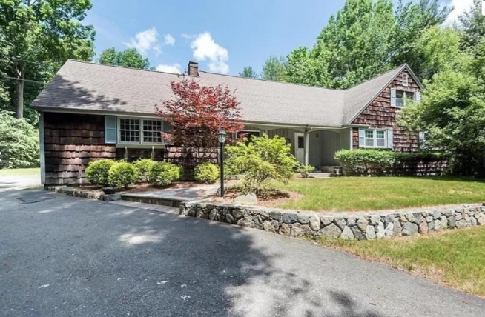
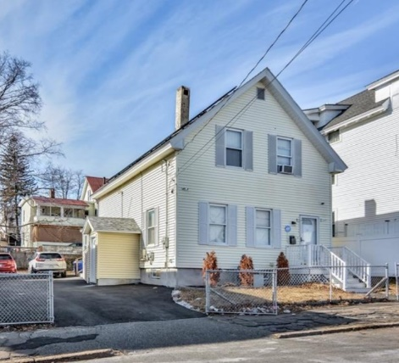
Current Day – Affordable Housing in Andover
Andover $829,000
Lawrence $308,000
Family Size 2022 Area Median Household Income From the HUD website: Area includes Andover, Lawrence, Boxford, Georgetown, North Andover, Haverhill, Methuen, Groveland, Merrimac, West Newbury 1 $80,550 2 $92,050 3 $103,550 4 $114,000 5 $124,300
Family Size 2022 Area Median Household Income required to purchase an Affordable Unit (80%): 1 $62,600 2 $71,550 3 $80,500 4 $89,400 5 $96,600
What is the median market rate single family home price in (2022)
Andover? $827,000
Lawrence? $490,000
Merrimack Valley? $595,000
Commonwealth of MA? $413,254
US? $329,750

Slide 5
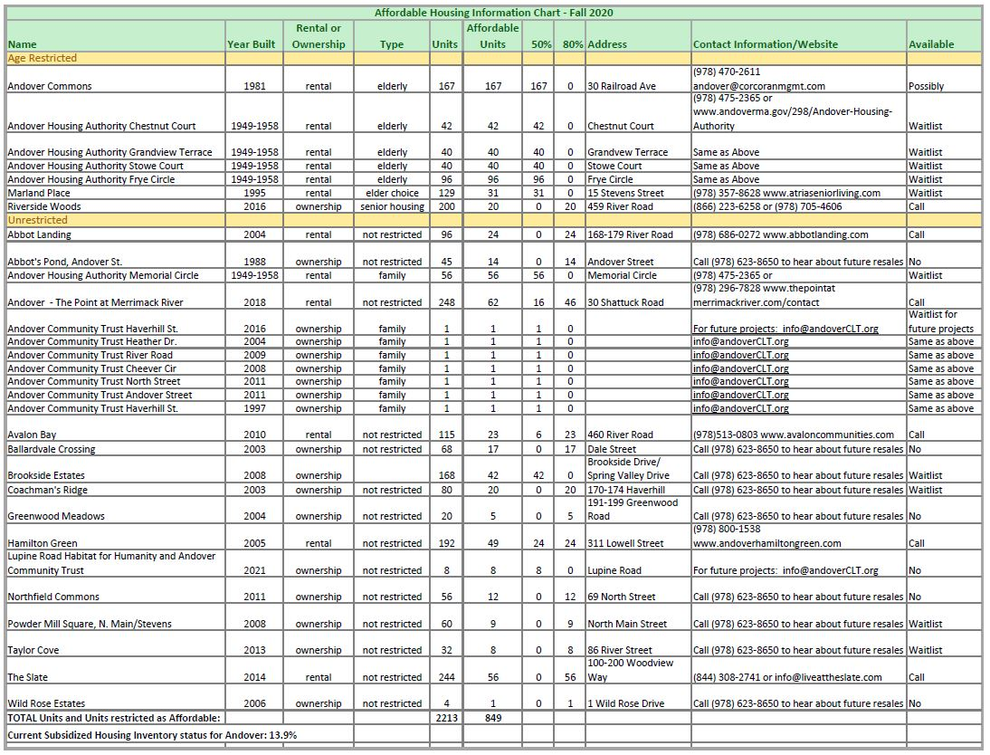
Current Day - Affordable Housing in Andover
Number of units through public housing, 40B, or inclusionary zoning = 1706
Actual affordable units = 849
13.9% is the current Subsidized Housing percentage as counted by the Commonwealth of Massachusetts (2010) 1706/12,324.
https://andoverma.gov/692/Housing

Slide 6
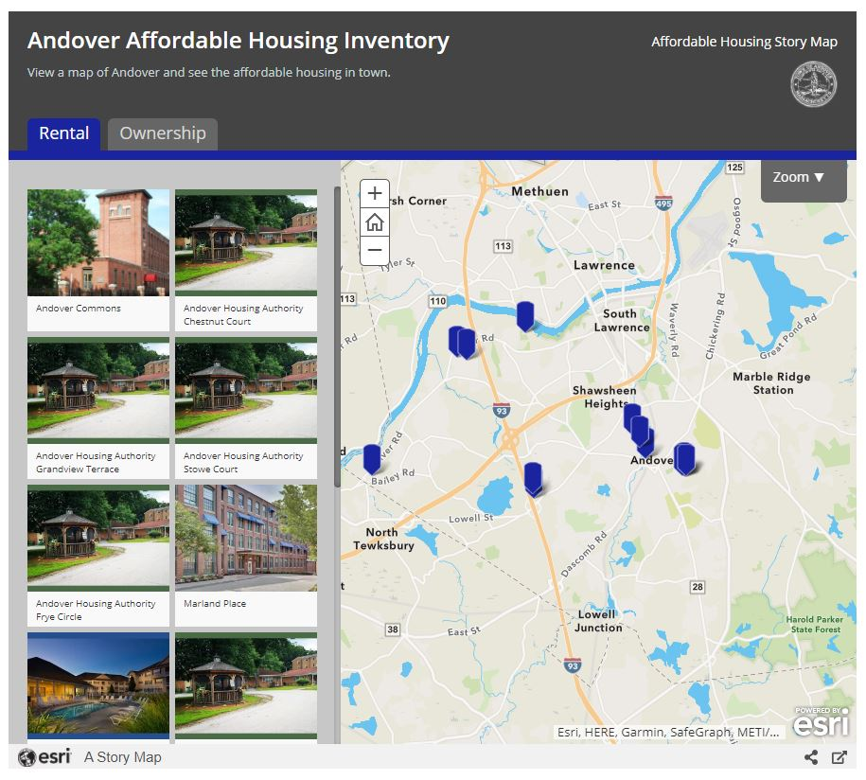

Slide 7
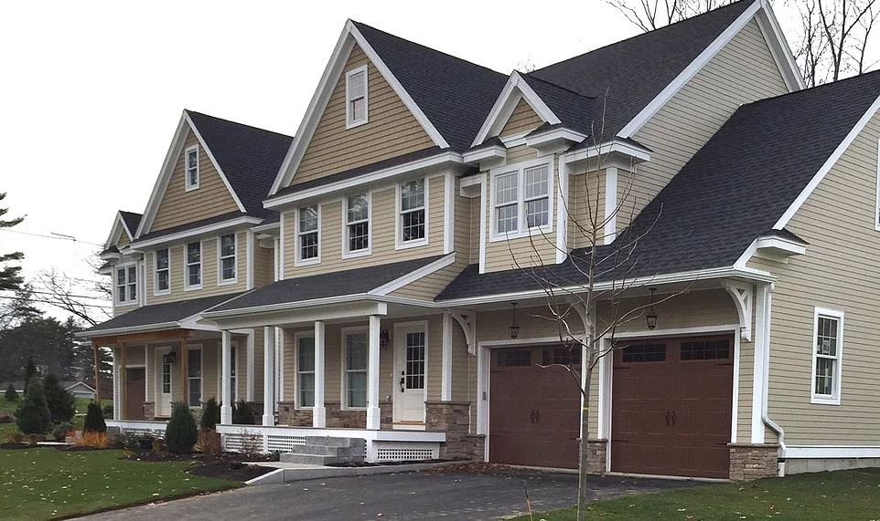
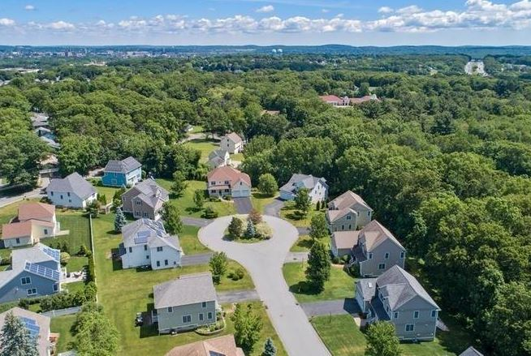
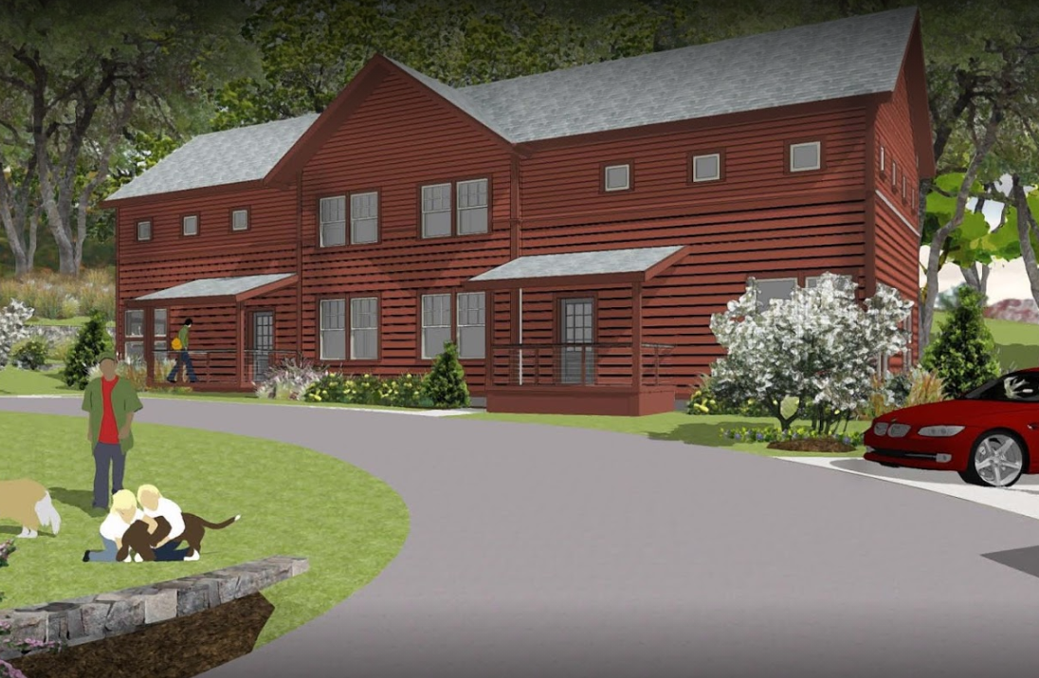
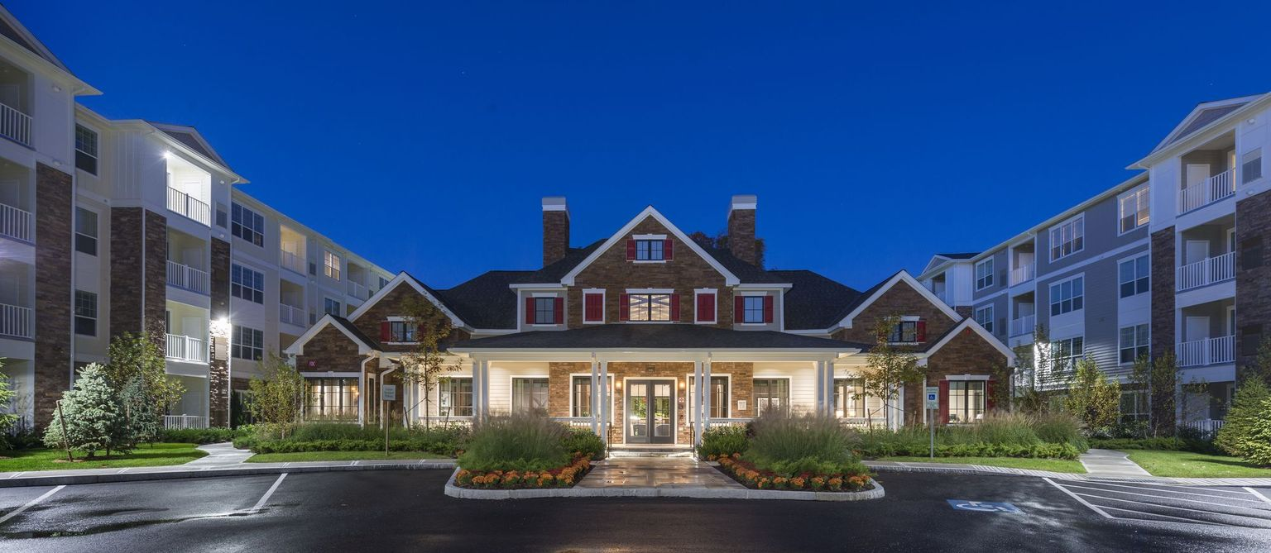
Examples of Affordable Housing around Andover

Slide 8
Moving Forward – Affordable Housing in Andover
What is Andover doing to keep building or encouraging affordable housing?
Historic Mill District (HMD)- There is opportunity to create market rate and affordable housing in the HMS using inclusionary zoning. The HMD allows up to 40 units/acre.
Town staff works closely with the Affordable Housing Trust Fund Board and local non-profits to help fund and support affordable housing initiatives.
The Town of Andover is reviewing the existing Zoning Bylaw to find areas that need improvement, including potential changes that could increase the supply of housing.
For example:
Allowing the creation of accessory dwelling units, ADU’s or “in-law” apartments.
Approving smaller lot zoning districts that put housing near existing activity centers and transit locations.
Granting increased density either by right and/or through a special permit process.
Reducing parking requirements and dimensional requirements, such as minimum lot sizes.

Slide 9
Contact Information:
Lisa Schwarz, Planning Division (978) 623-8652 Lisa.Schwarz@andoverma.us
Town of Andover Website: https://andoverma.gov/692/Housing
Andover Zoning Bylaw https://www.ecode360.com/15582155

Slide 10



Current Day – Affordable Housing in Andover
What does 13.9% mean?
The Subsidized Housing Inventory (SHI) is used to measure a community's stock of low-or moderate-income housing for the purposes of M.G.L. Chapter 40B (Comprehensive Permit Law). While housing developed under Chapter 40B is eligible for inclusion on the inventory, many other types of housing also qualify to count toward a community's affordable housing stock.
In Andover, the Commonwealth considers 1713 of our 12324 housing units to “count” towards our SHI. Once a community is over 10%, then it is much more difficult to use the 40B process to override zoning.
What is Median Household Income? It includes the income of the householder and all other individuals 15 years old and over in the household, whether they are related to the householder or not. Median is not the average, median divides the income distribution into two equal parts: one-half of the cases falling below the median income and one-half above the median income.
What is Andover’s Median Household Income? According to the Merrimack Valley Planning Commission Data Source Andover’s current median household income is $188,785
Area Median Household Income refers to the median of a grouped number of communities.
The Area Median Income for a family of four for our area is $115,100. This is because Andover is grouped with the surrounding communities which lowers the overall area median income. For example, Lawrence’s median household income is $44,752. When it comes to determining eligible households, the AREA Median Income is used.

