Slide 1
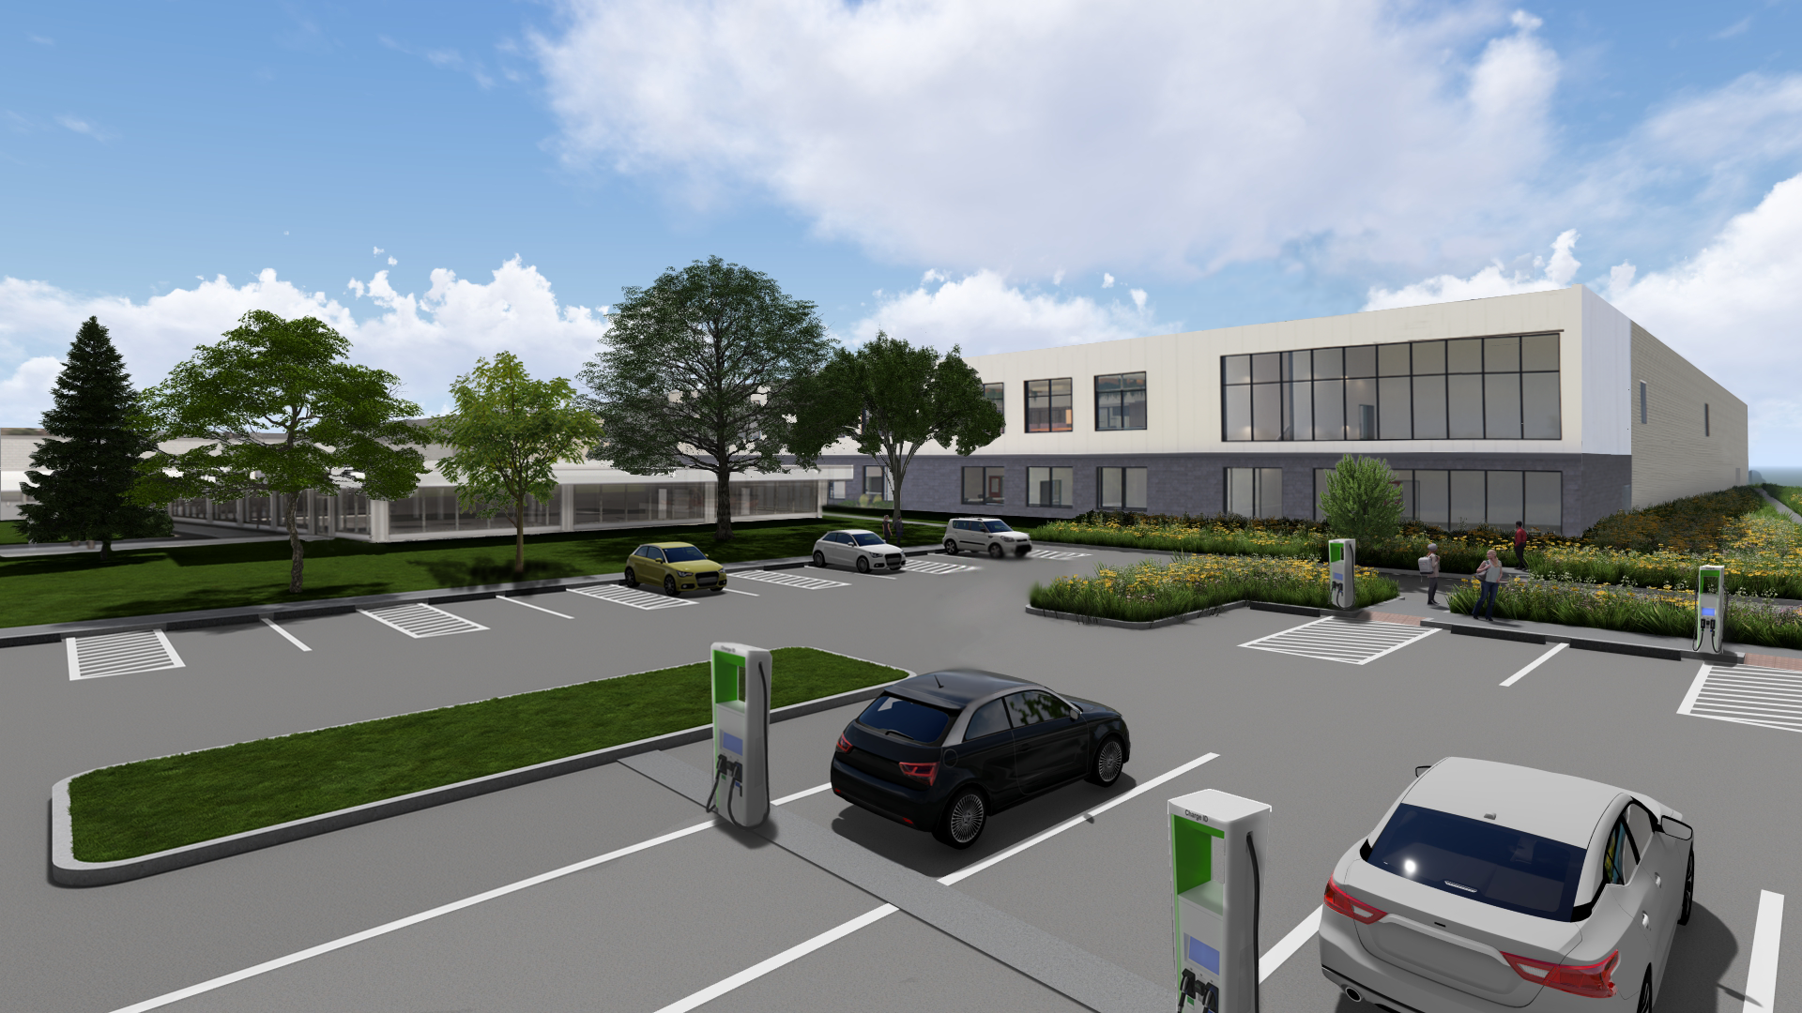

P&G Andover Manufacturing Center
Enhancement Project

Slide 2
Andover Site
Gillette has been a partner in the Massachusetts community for over 120 years
Longstanding history of innovation in the Commonwealth
Committed to continuing being a community partner as we move to Andover
Health and safety of our community and our operations is a top priority

Slide 3
Presentation Outline
Traffic
Parking
Tewksbury Residents
Environmental performance
Q&A and Next Steps

Slide 4
Traffic
Vanasse Response to GPI Peer Review Letters #1 on 8/1.
GPI Peer Review Letter #2 on 9/10
  Vanasse Response to GPI Peer Review Letter #2 on 9/17.
GPI Peer Review Letter #3 on 9/24
Mitigation Discussions with Town DPW underway

Slide 5
Traffic Mitigation
DPW – Gillette discussion on Andover-River St intersection
Gillette and DPW Agree Option 3 (Signalization) is the Best Solution

Slide 6
Traffic Mitigation Proposal
With input from DPW and Planning Board, Gillette to provide funding toward the following:
  All-Way Stop Signs at Lowell Junction Road/Connector Road
  Rectangular Rapid Flashing Beacon on River Street
  Solution at Andover Street/River Street Intersection

Slide 7
Parking
Previously showing 654 Spaces
Compact spaces would add 13; total would be 667
Estimated max. usage of 598 is 89% of 667 Spaces
Operational solutions; Shift Schedule, Construction and New Business
Parking Monitoring Study will be conducted
Reserve parking deck could be built in stages
  Fully built is 1,965 spaces
  Current requirement is 965 spaces

Slide 8
Tewksbury Residents
Vibration – conducted two rounds of tests confirming that vibrating roller will not generate perceptible vibration in Tewksbury neighborhoods
Highway Noise – committed to performing baseline ambient noise testing at Gillette expense. No anticipated change in perceptible noise.
Continuing outreach during construction

Slide 9
P&G’s Longstanding Commitment to
Health, Safety, and Environment
Long history of Environmental Protection and Compliance in Andover, South Boston and Globally
Systemic approach to HS&E performance.
HS&E Industry leading results
We do the right thing

Slide 10
AMC Environmental Continuous Improvement
Recent Results at Andover Site
3,900 GJ (>1MM kwh) Absolute Energy Reduction (-4% YoY)
61 tons Absolute GHG Reduction (-2% YoY)
13,000 m3 (>3.4MM gal) Water Reduction (-8% YoY)
And,
AMC moved from being a Major Source to Non-Major in 2014
We’ve made significant Air Emissions Reductions in the past 20 years:
  NOX reduced > 75%
  SO2 reduced ~ 100%
  CO reduced > 90%
  VOC reduced > 40%
  PM reduced > 95%
  CO2 reduced ~ 40%

Slide 11



Project Sustainability Improvements
The Andover site expansion is integrating best in class design and technologies to reduce the use of water and energy
New building designed to avoid GHG generation:
  Efficient building envelope
  Recovery of Process Heat to support HVAC requirement
  Fully electric Building (buying green electricity)
  90% of GHG reduction in MA by ~ 30,000 TPY
^{GHG}
Project Water Usage & Effluent Discharge Reduction
  High-efficiency water treatment and cooling tower systems
  On-site water recovery and reuse
  Real-time measuring and reporting capability
^{Water}
Efficient use of Energy.
  EV Parking Spaces to be Installed
  LED lights and Sky-lights to reduce consumption
  Modular design of utilities to minimize power use
  Real-time measuring and reporting capability
^{Energy}
Improving Gillette’s environmental footprint in Massachusetts

Slide 12
On-site Materials
History of safely managing and preventing incidents with materials at the Andover and Boston Sites
Robust standards and capability on site
Thorough systemic evaluation of any new material coming to site
Good partnership with local emergency response teams
All materials used on site comply with all laws and regulations, and meet high levels of health and safety standards

Slide 13
Non-Major Air Quality Permit
Future emissions remain ~ 1/4th of past permitted Andover Site emissions
No cogeneration / combustion turbine at Andover
Received MA DEP (Non-Major) Air Quality Plan Approval – September 12th
Approval concluded:
  Emissions meet all MADEP regulatory requirements
  Best Available Control Technology implemented for all emission sources

Slide 14
Wastewater
Anticipate permit update for project
  Minor increase in industrial discharge
  Peak discharge less usage than max. historical
  Reviewed project with GLSD in Jul 2024
  Application following final design late 2024
Alignment from Andover Public Works on water usage and wastewater volumes

Slide 15
Thank you!

